Slide 1
Lab 1 C
Dr : Ghada
Eng : Gehad
Eng : Somaya

Slide 2
Content
Installation
CodeBlocks &gcc
variables and Data Types
int
char
Float
Escape Sequence
Operators
Arithmetic operators
Relational Operators

Slide 3
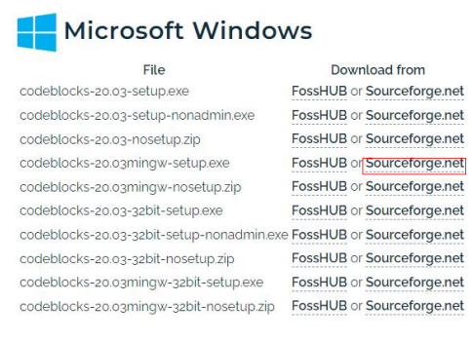
Installation
Link :
https://www.codeblocks.org/downloads/binaries/
Watch video :
https://youtube.com/watch?v=r4JkIjAx9TY&feature=s hare

Slide 4
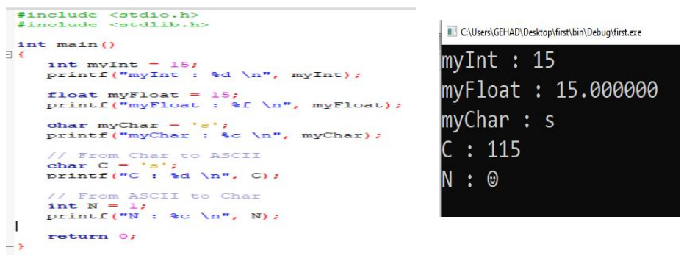
variables and Data Types
Syntax : type variableName = value;

Slide 5
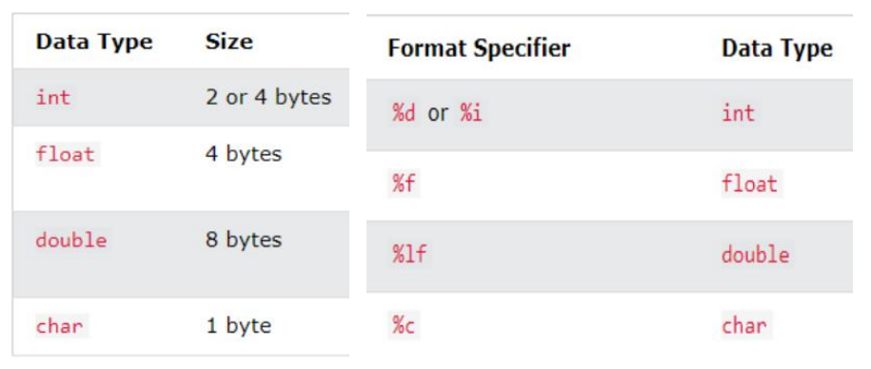
variables and Data Types

Slide 6
Operators
Arithmetic operators
Relational Operators

Slide 7
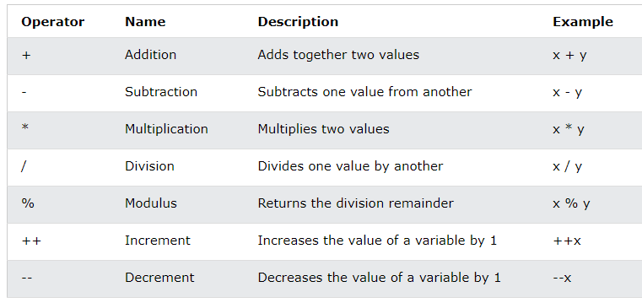
Arithmetic operators

Slide 8
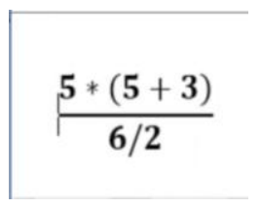
Try This

Slide 9
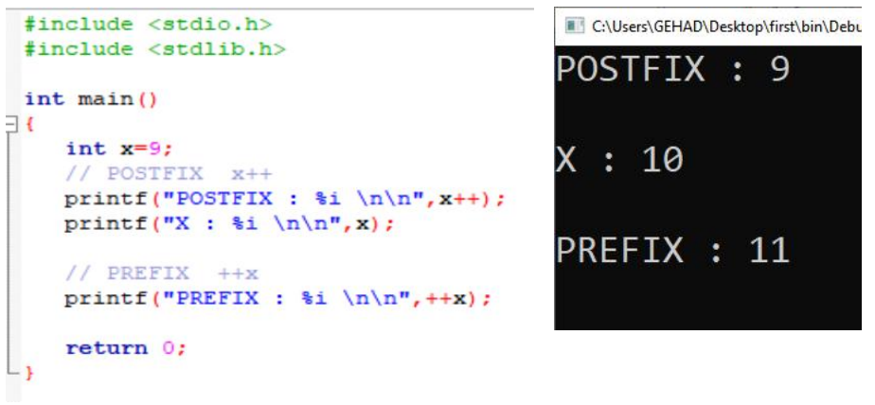
Increment and decrement

Slide 10
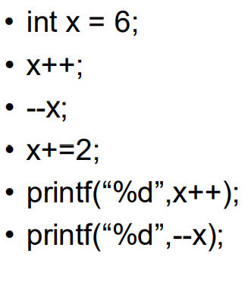
Try This

Slide 11
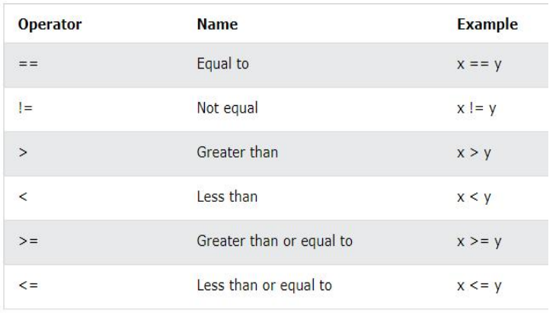
Relational Operators

Slide 12
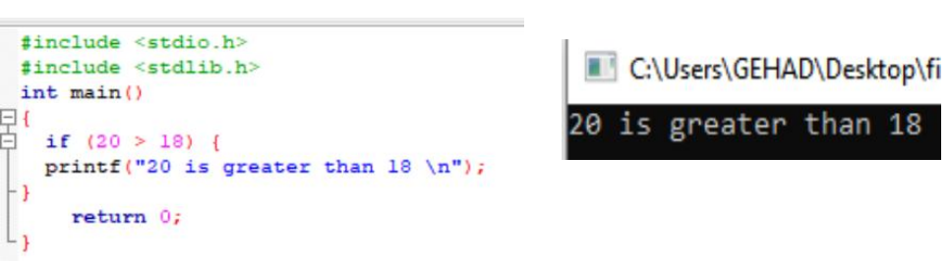
Conditional statements
Syntax : if (condition)
{ // block of code to be executed if the condition is true}

Slide 13
Try This
Make sure that the password entered is 1234, and if it is not correct, print no.

Slide 14
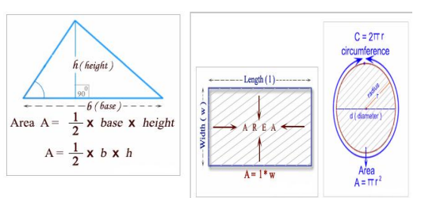
Try This
Write a C program to compute the area of the various geometrical shape.
– set 1 for area of circle
– set 2 for area of rectangle
– set 3 for area of triangle
– set your choice : 1
– set radius of the circle : 5
– The area is : 78.500000

